Slide 1

Example of how to calculate connections
http://people.uncw.edu/lugo/courses/diffgeom/dg1.pdf

Slide 2
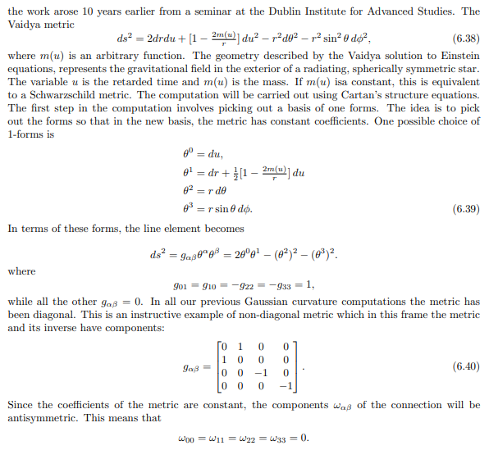

Slide 3
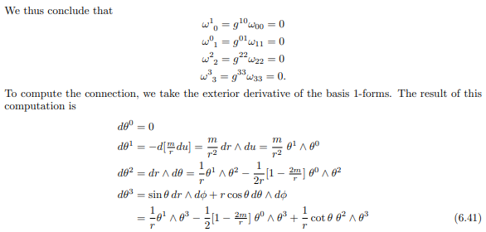

Slide 4
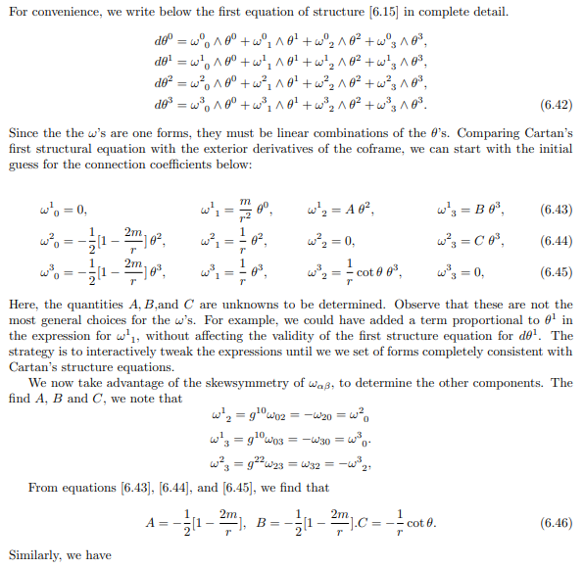

Slide 5
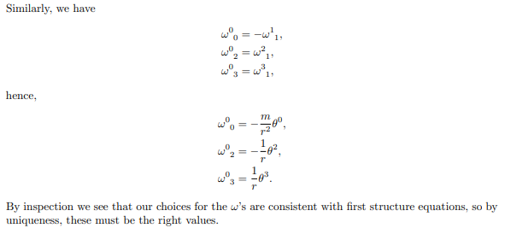

Slide 6
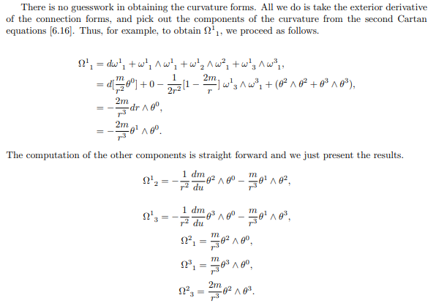

Slide 7
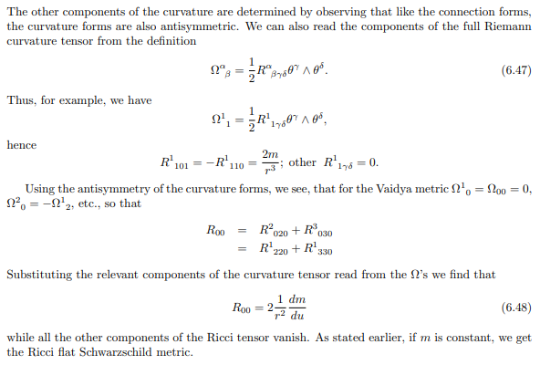

Slide 8


Slide 9
Example of how to calculate Gaussian curvature
http://www.mi-ras.ru/~kazarian/papers/geomim.pdf

Slide 10
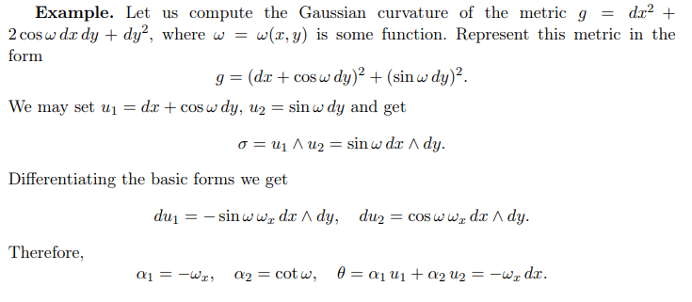
http://www.mi-ras.ru/~kazarian/papers/geomim.pdf

Slide 11
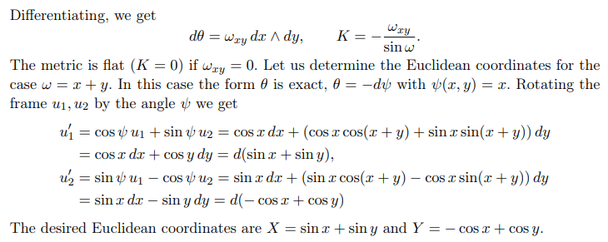
http://www.mi-ras.ru/~kazarian/papers/geomim.pdf

